Slide 1
Introduction to Business Analytics: Communicating with Data
Module 3
Professor Kevin Hartman

Slide 2
In This Module
Module 3: Your Guide to Creating Visualizations
Key Concepts
Finding patterns in data
Being planful when creating dataviz
Understanding the components of visual form
Creating inviting dataviz

Slide 3
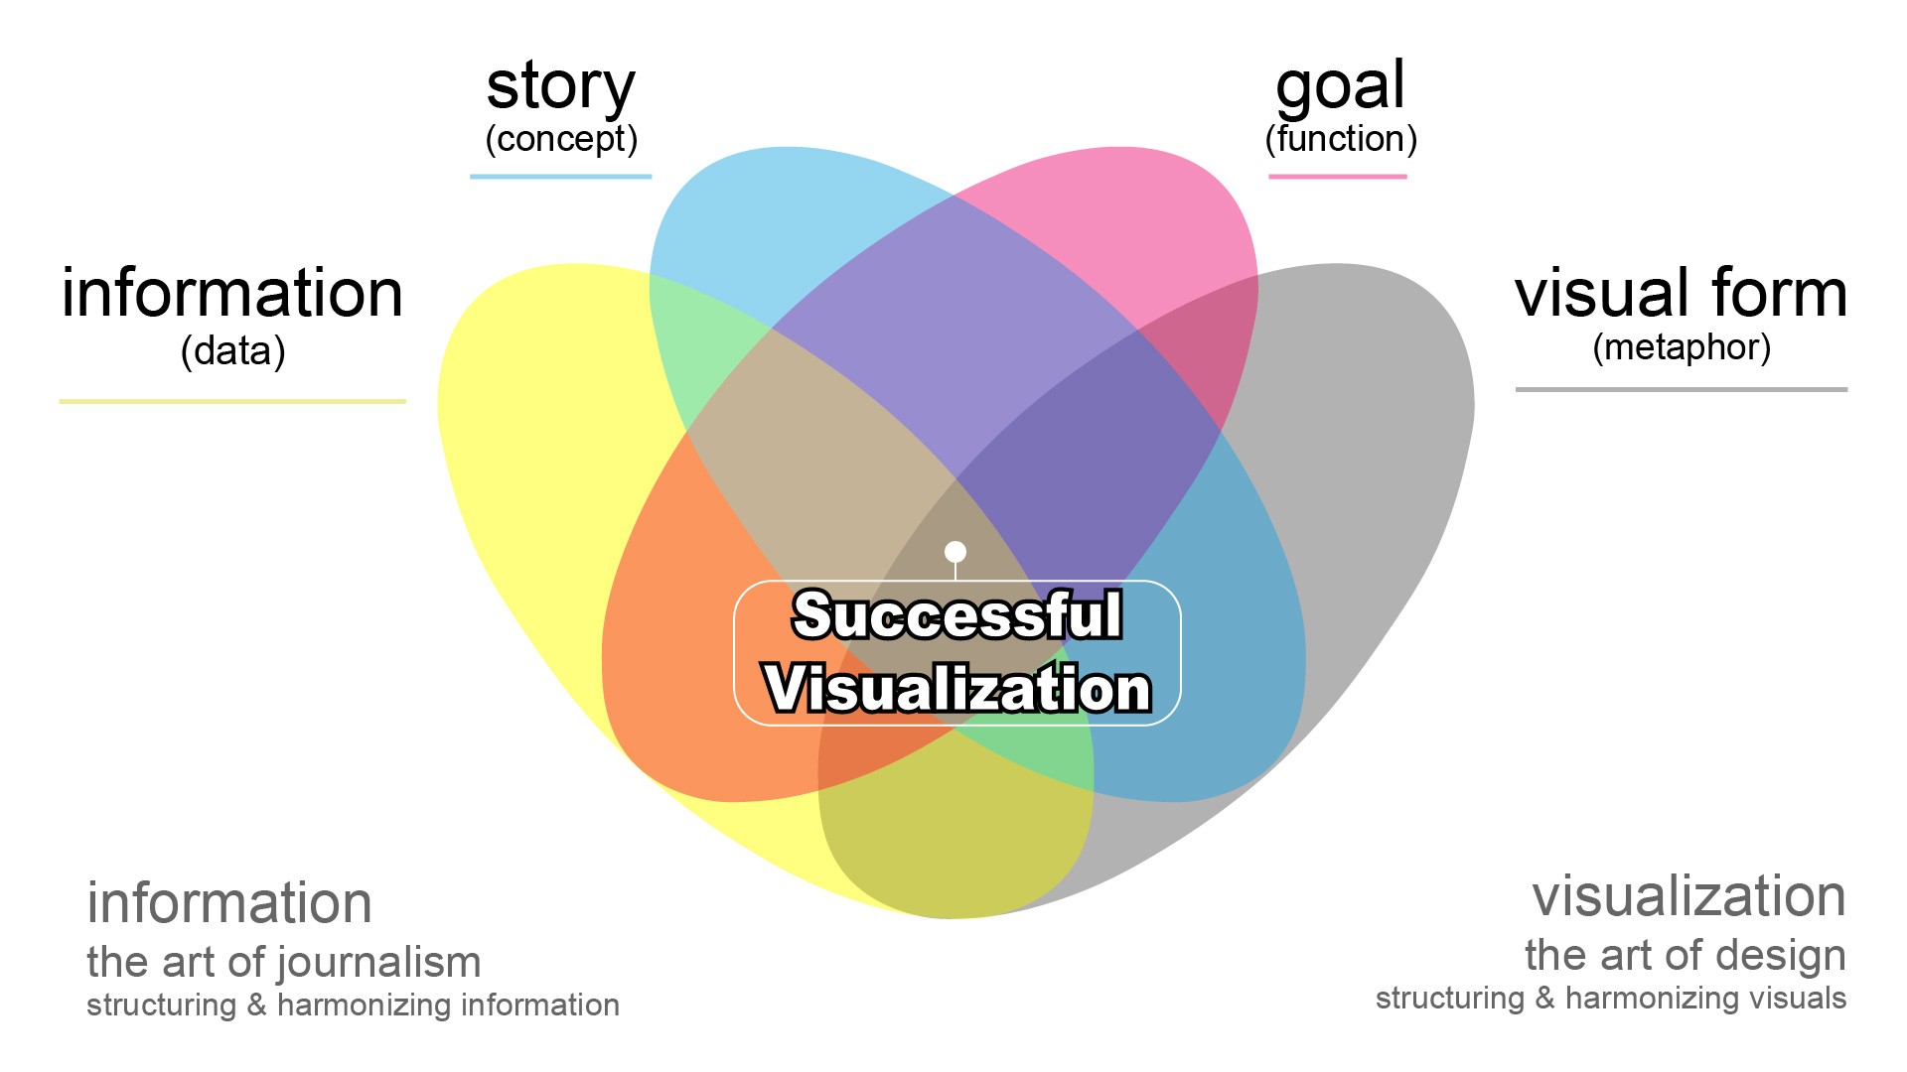
McCandless Offers a Thorough Definition of Good Data Stories

Slide 4
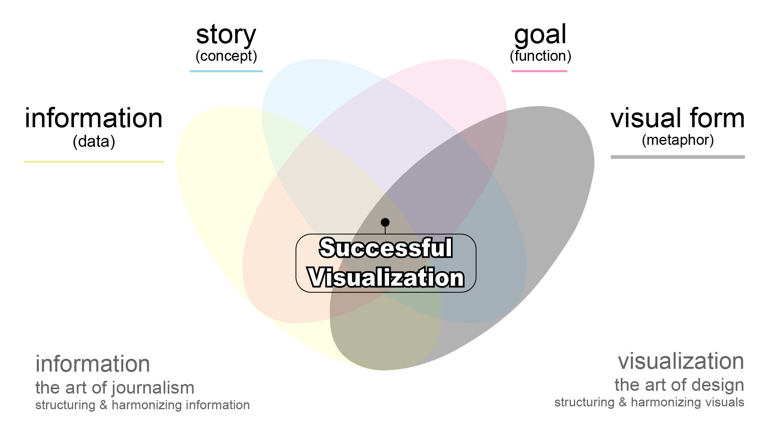
McCandless Offers a Thorough Definition of Good Data Stories

Slide 5




Slide 6
Applying Minto’s Ideas to Data Pursuit Ensures a Sound Approach
To increase sales, Bellabeat
must first grow awareness
What is the level
of awareness for Bellabeat today?
How has awareness
for Bellabeat changed
over time?
Why is awareness critical for Bellabeat’s product adoption?
Bellabeat
Awareness
Study
Facebook
Page Likes
Google Search
Share of Voice
Bellabeat
Website Traffic
Reports
FB Likes
over Time
Google Trends
Search Volume
Bellabeat Sales
over Time
Bellabeat Aware-
ness over Time
Tech Adoption
over Time
Source: Adapted from Barbara Minto “The Pyramid Principle.”
Notes:
When developing pyramids, three rules are applied to ensure coherence. In addition, a guiding principle (MECE) is used to test a pyramid’s completeness.

Slide 7
Applying Minto’s Ideas to Data Pursuit Ensures a Sound Approach
To increase sales, Bellabeat
must first grow awareness
What is the level
of awareness for Bellabeat today?
How has awareness
for Bellabeat changed
over time?
Why is awareness critical for Bellabeat’s product adoption?
Bellabeat
Awareness
Study
Facebook
Page Likes
Google Search
Share of Voice
Bellabeat
Website Traffic
Reports
FB Likes
over Time
Google Trends
Search Volume
Bellabeat Sales
over Time
Bellabeat Aware-
ness over Time
Tech Adoption
over Time
Source: Adapted from Barbara Minto “The Pyramid Principle.”
Notes:
When developing pyramids, three rules are applied to ensure coherence. In addition, a guiding principle (MECE) is used to test a pyramid’s completeness.

Slide 8
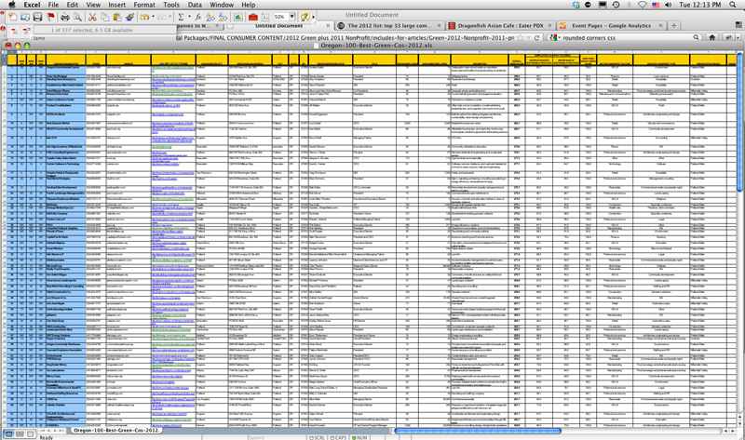

Slide 9
Finding Patterns in Data
Module 3 Lesson 1

Slide 10
Finding Patterns in Data
Visualizing data can unlock insights previously unseen, but the approach you select must match your meaning

Slide 11
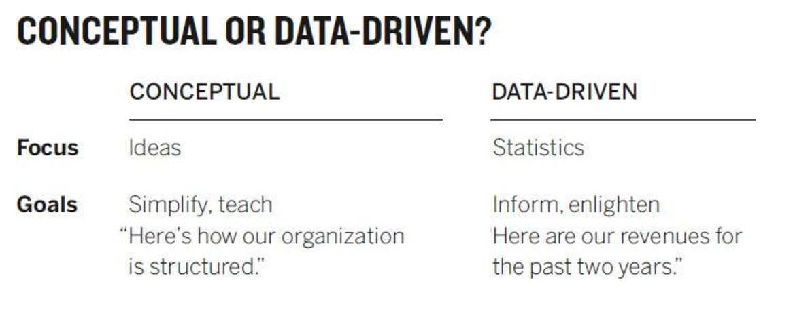
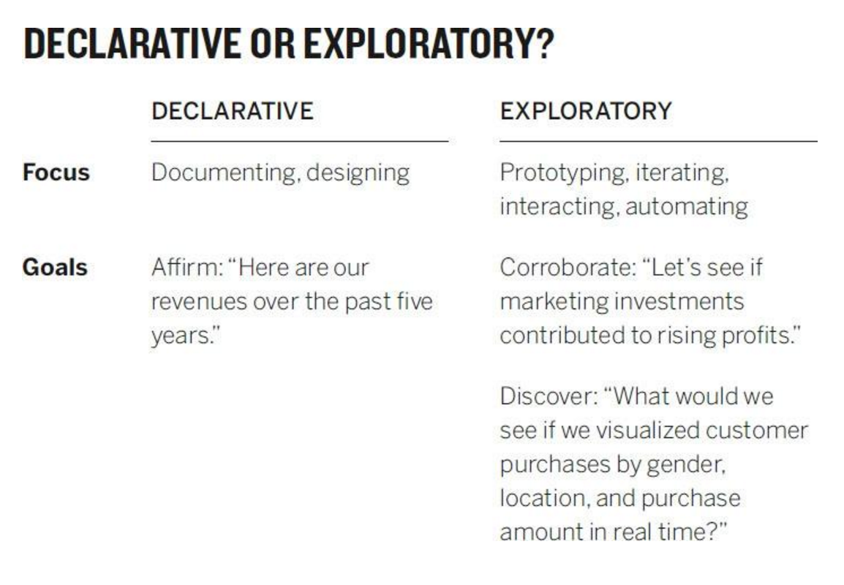
Analyzing Data Effectively Begins with Understanding
Conceptual or data-driven?
Declarative or exploratory?
Focus
Goals
Conceptual
Ideas
Simplify, teach: “Here’s how our organization is structured”
Data-driven
Statistics
Inform, enlighten: “Here are our revenues for the past two years”
Focus
Goals
Declarative
Documenting, designing
Affirm: “Here is our search spend over the past five years”
Exploratory
Prototyping, iterating, interacting, automating
Discover: “What would we see if we visualized customer purchases by gender?”
Source: Adapted from Scott Berinato, “Good Charts: The HBR Guide to Making Smarter, More Persuasive Data Visualizations.”

Slide 12
Your dataviz nature and purpose are framed well on a 2 x 2
The four types of charts
Declarative
Conceptual
Data-Driven
Exploratory
Source: Adapted from Scott Berinato, “Good Charts: The HBR Guide to Making Smarter, More Persuasive Data Visualizations.”

Slide 13
Each quadrant requires different forms of visualization
The four types of charts
Declarative
Idea illustration
Everyday dataviz
Conceptual
Data Driven
Idea generation
Visual discovery
Exploratory
Source: Adapted from Scott Berinato, “Good Charts: The HBR Guide to Making Smarter, More Persuasive Data Visualizations.”

Slide 14
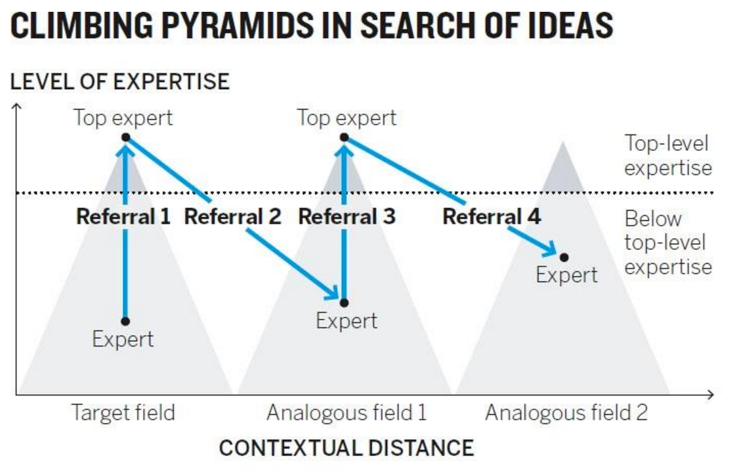
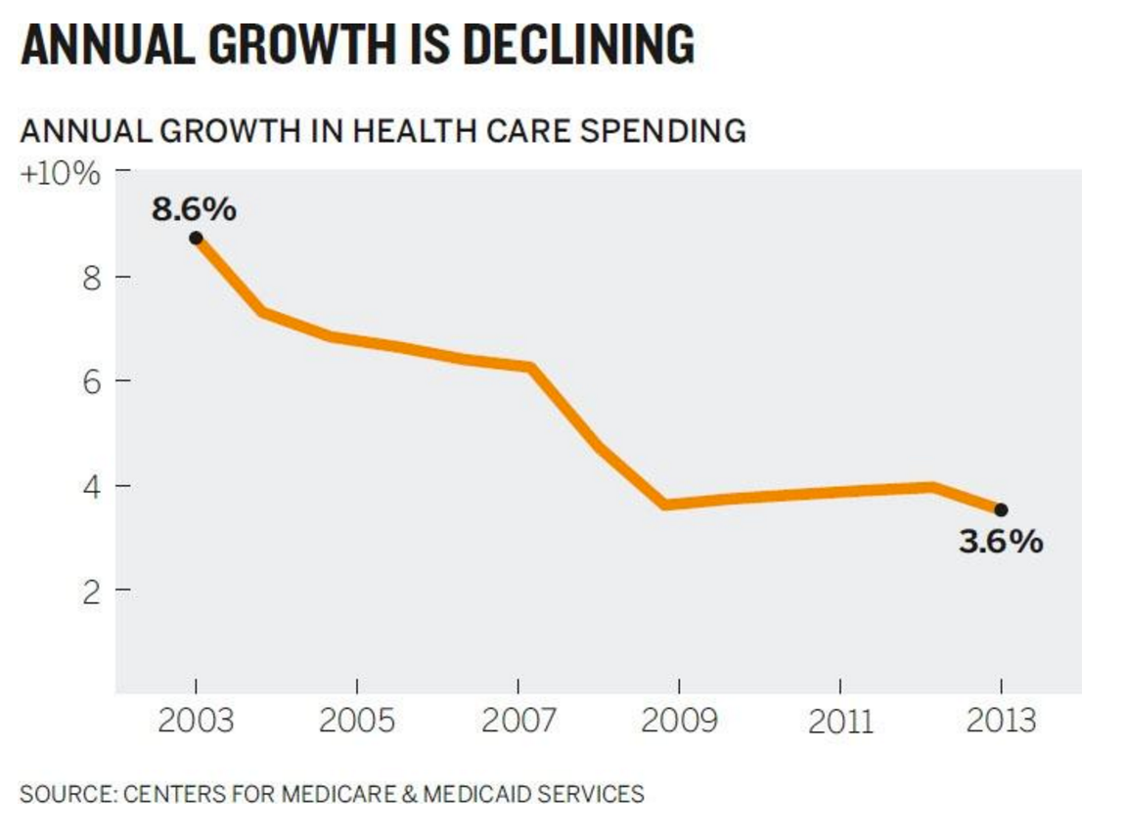
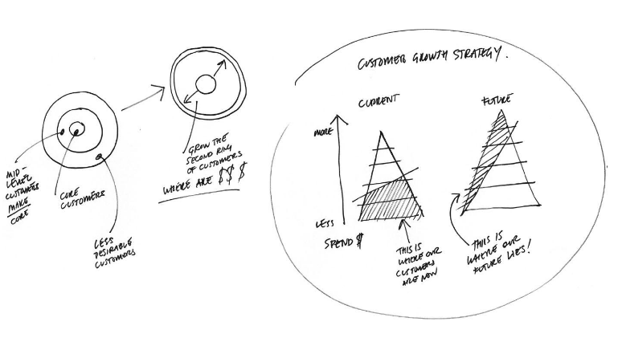
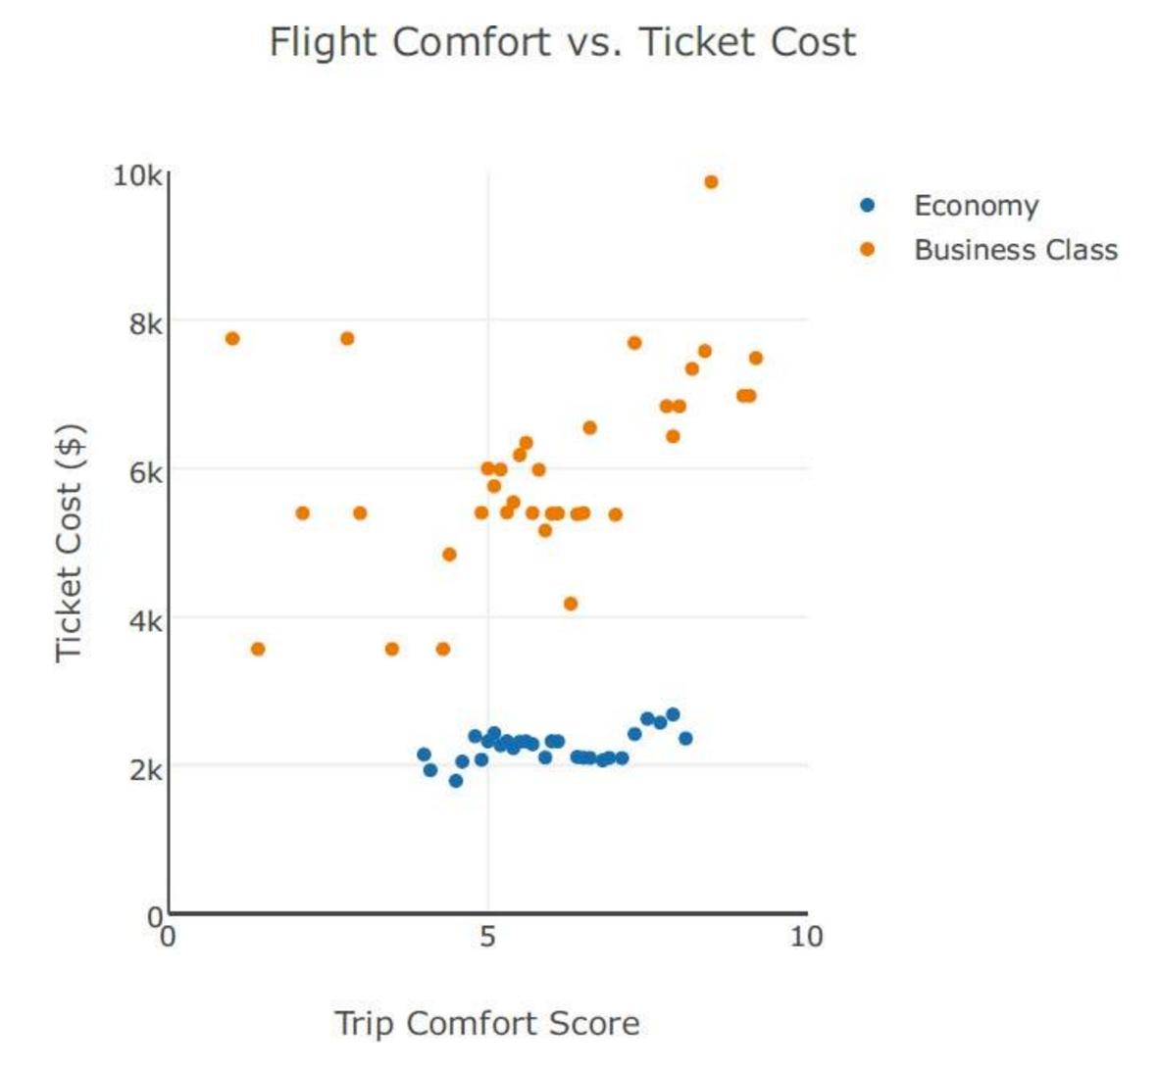
Data storytelling is best done when charts are involved
The four types of charts
Declarative
Conceptual
Data Driven
Exploratory
Source: Adapted from Scott Berinato, “Good Charts: The HBR Guide to Making Smarter, More Persuasive Data Visualizations.”

Slide 15
Data storytelling is best done when charts are involved
The four types of charts
Declarative
Conceptual
Data Driven
Exploratory
Source: Adapted from Scott Berinato, “Good Charts: The HBR Guide to Making Smarter, More Persuasive Data Visualizations.”

Slide 16
Meaningful Patterns in Data-Driven Charts Take Many Forms
Change: The trend or instance of observations becoming different over time
Clustering: Collection of data points with similar values
Relativity: Observations considered in relation or in proportion to something else
Ranking: A position in a scale of achievement or status
Correlation: A mutual relationship or connection between two or more things

Slide 17


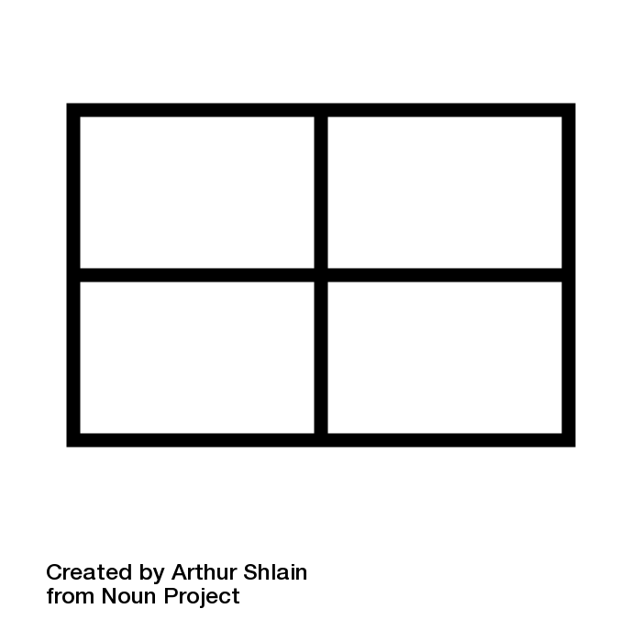



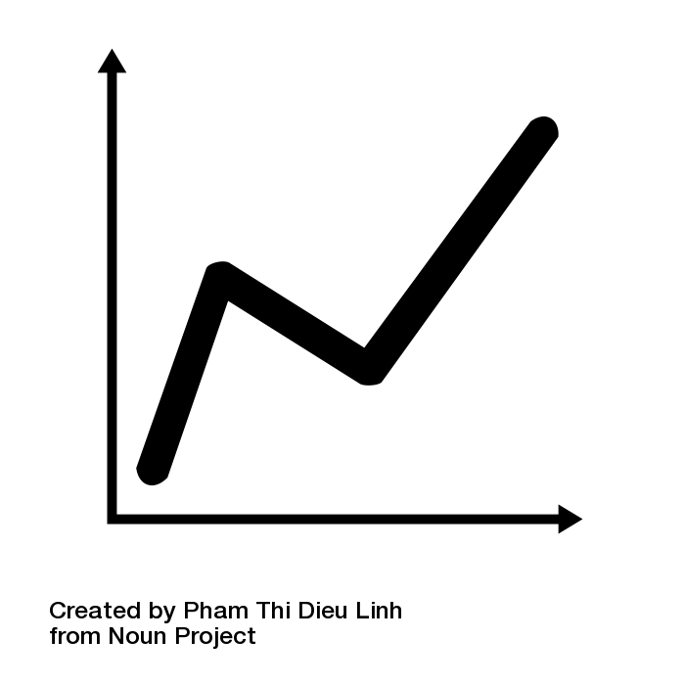


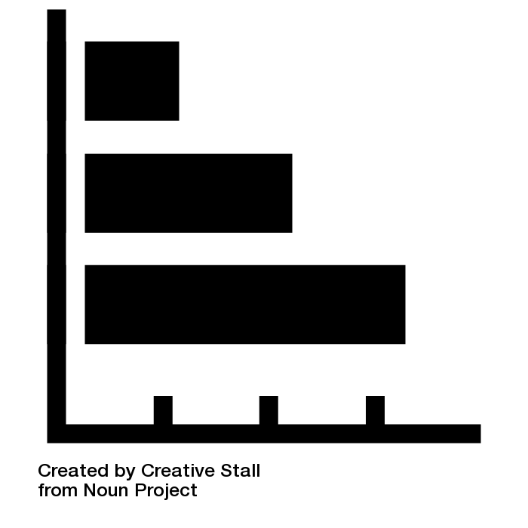
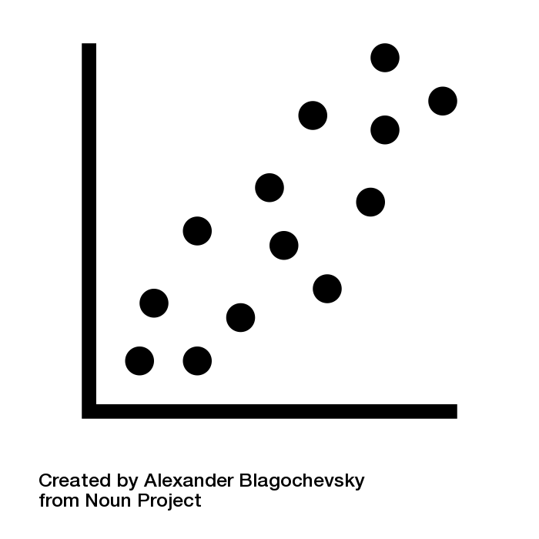

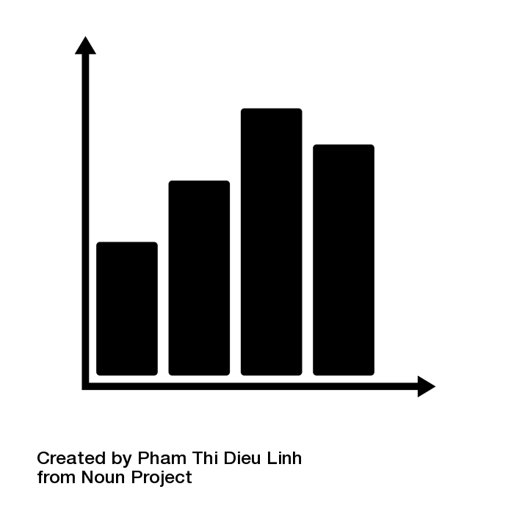
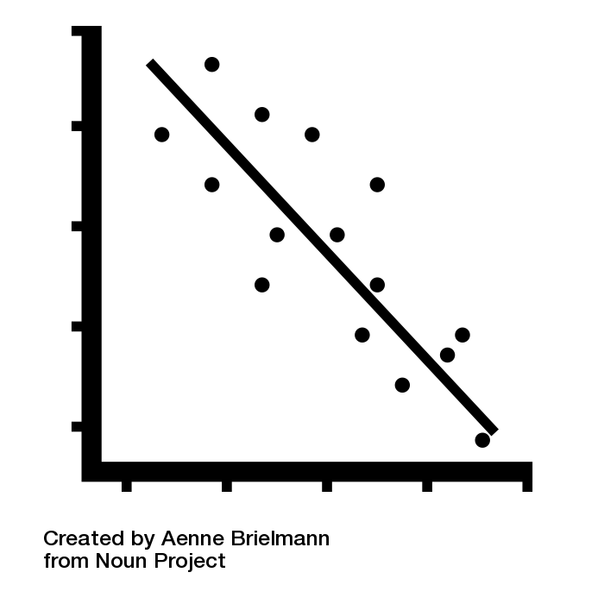



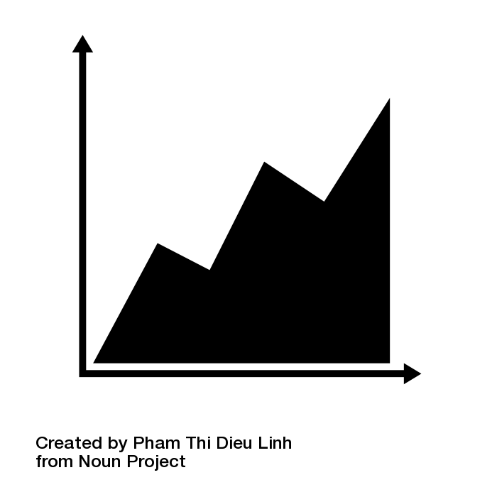

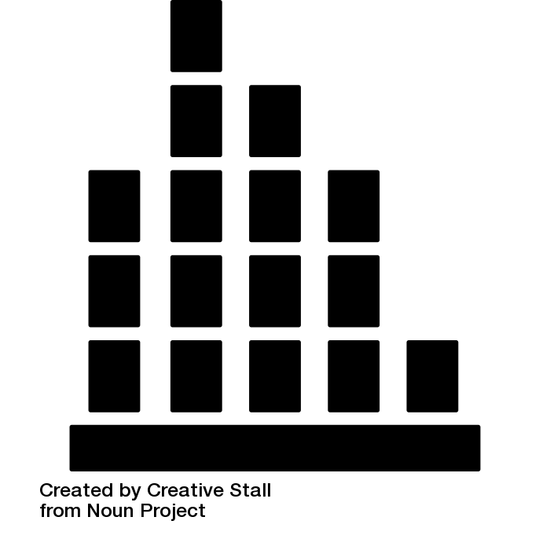
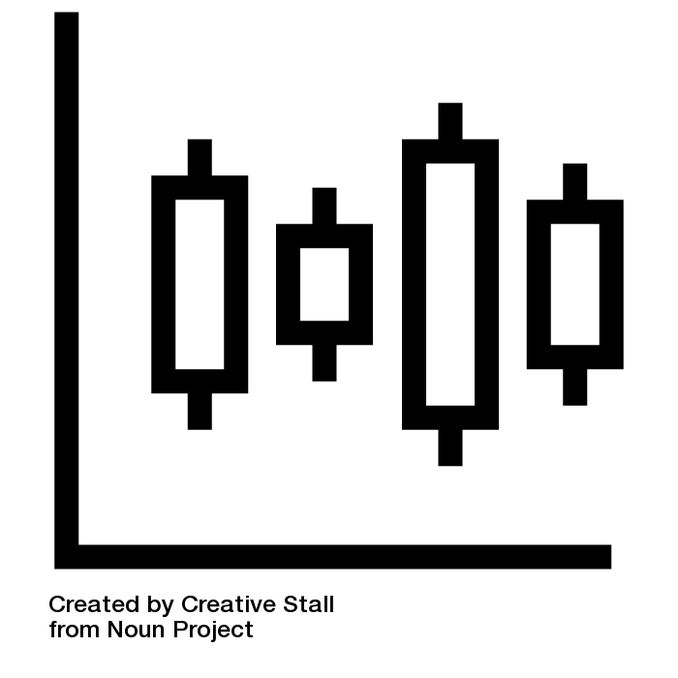




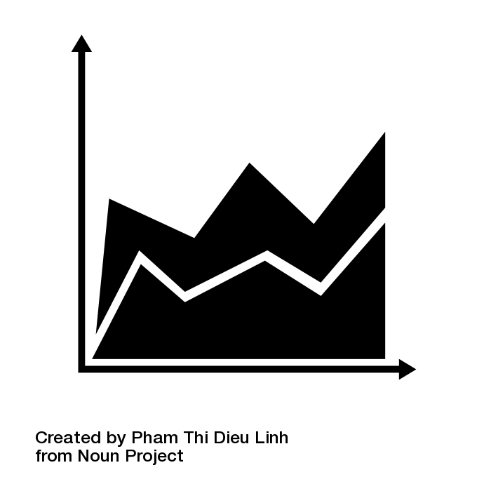

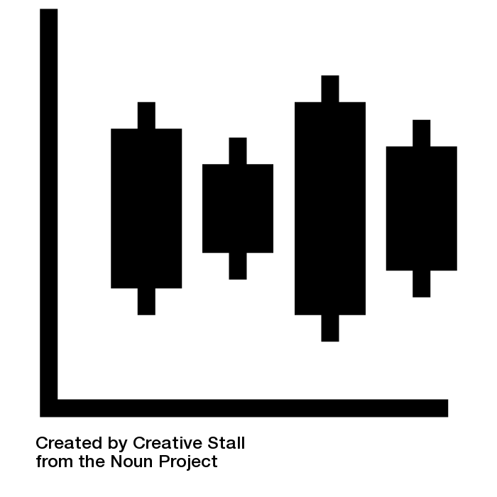


Specific Visualizations Best Express Data-Driven Patterns
Change
Clustering
Relativity
Ranking
Correlation
Line
Bubble
Pie
Bar
Scatter
Column
Distribution
Tree Map
Spider
Regression
Histogram
Candlestick
Word Cloud
Sankey
Double Bar

Slide 18
Visuals Aid in the Communication of Conceptual Ideas
Description: An account of an object or observation that aids in furthering understanding
Classification: A sort of something according to qualities or characteristics it shares with others

Slide 19
Visuals Aid in the Communication of Conceptual Ideas
Structure: The arrangement of and relations between parts or elements of something complex
Evaluation: A judgment about the amount, number, or value of something
Process: A series of actions or steps taken in order to achieve a particular end

Slide 20






Conceptual Ideas Come to Life via Effective Visualization
Description
Classification
Structure
Evaluation
Process
Venn Diagram
Logic Tree
Organization
Harvey Ball
Chevron
Inductive Diagram
2 x 2 Matrix
Map
Comparison Matrix
Flow
Conceptual Structure
Word Tree
Labeled Diagram
Score Card
Gantt
Notes:
Inductive = looking for trend or pattern and then generalizing (like modeling)
Deductive = starting with facts and deducing other facts (like math)

Slide 23
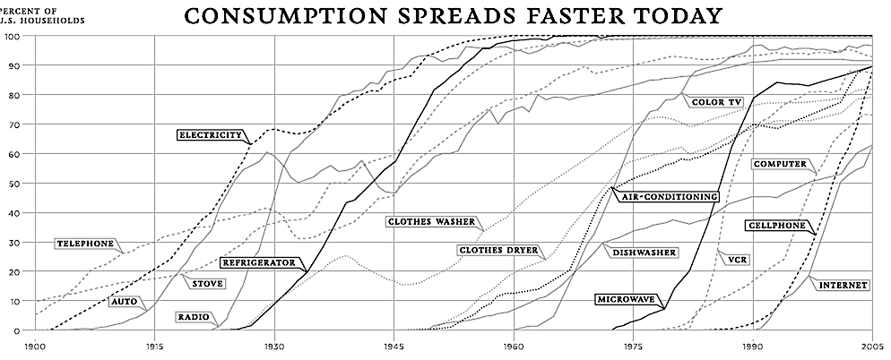
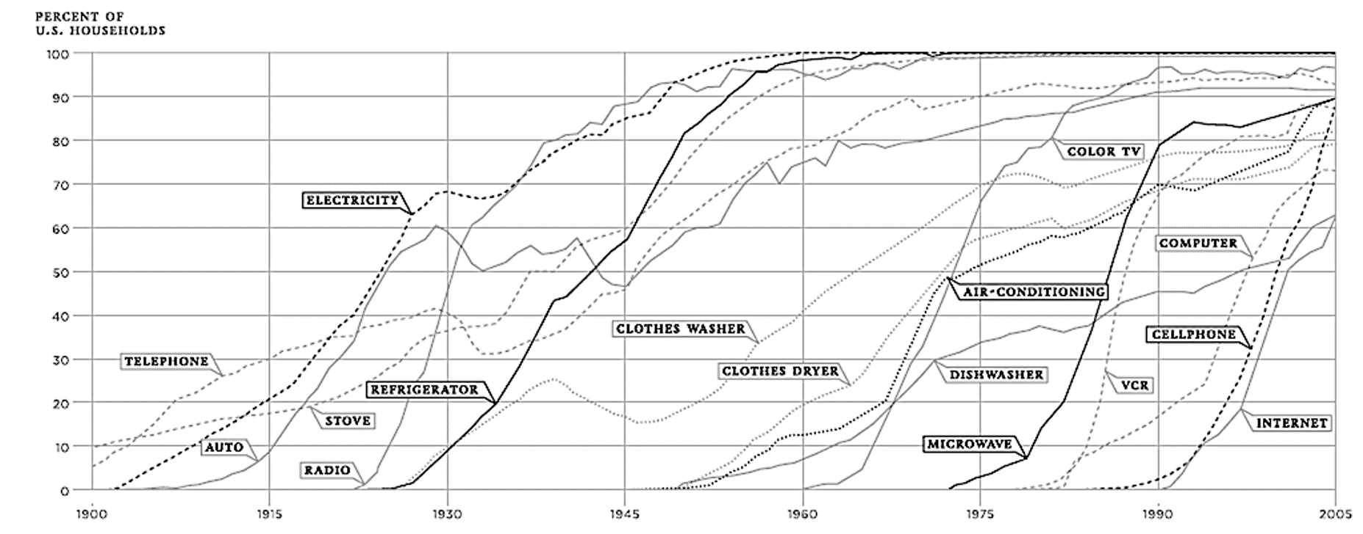
Source: New York Times, Nicholas Felton
Notes:
https://www.theatlantic.com/technology/archive/2012/04/the-100-year-march-of-technology-in-1-graph/255573/
https://archive.nytimes.com/www.nytimes.com/imagepages/2008/02/10/opinion/10op.graphic.ready.html
https://www.technologyreview.com/s/427787/are-smart-phones-spreading-faster-than-any-technology-in-human-history/
http://www.pewresearch.org/fact-tank/2014/03/14/chart-of-the-week-the-ever-accelerating-rate-of-technology-adoption/
https://www.theatlantic.com/technology/archive/2012/03/guess-whats-the-fastest-adopted-gadget-of-the-last-50-years/254948/
One more example, this time going from a visualization and re-engineering it using the rules we’ve discussed to see if we can more efficiently convey meaning and improve the chance that our message will be remembered by our audience. There is a lot going on on this chart. One data point for each year since 1900 means over 100 data points for telephone alone; and there are 16 technologies (http://mike-pulsifer.org/2009/08/the-chart-make-over-challenge-of-2009/). Hue is used, as are other pre-attentive attributes such as width. And there are some callouts, as the message “consumption spreads faster today” is prominent. But it is difficult to find the data in the message.

Slide 24


Slide 25
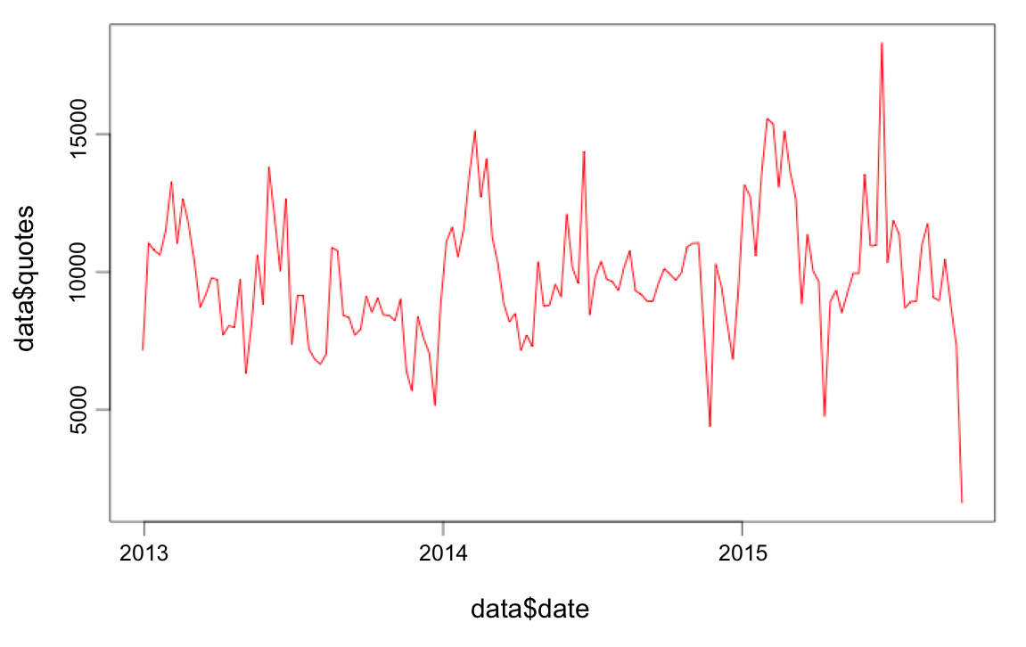
Plot ⎯ Time Series

Slide 26
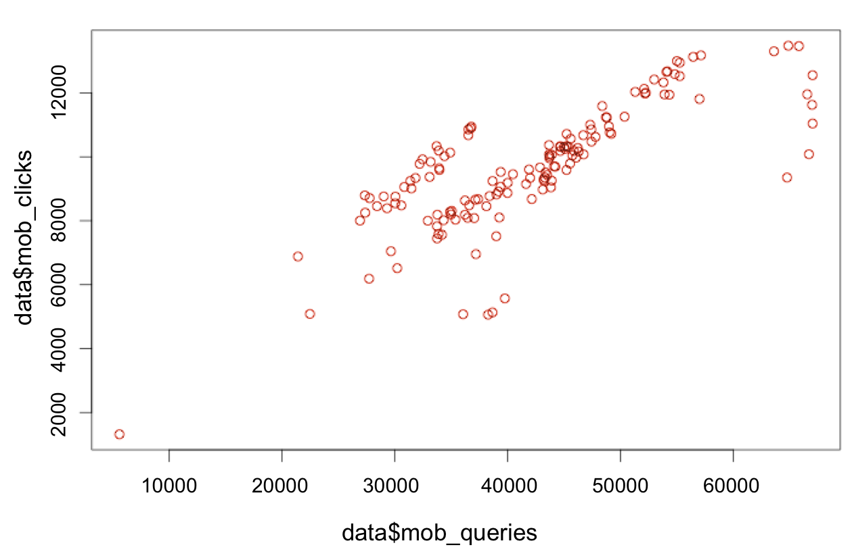
Plot ⎯ Relationship

Slide 27
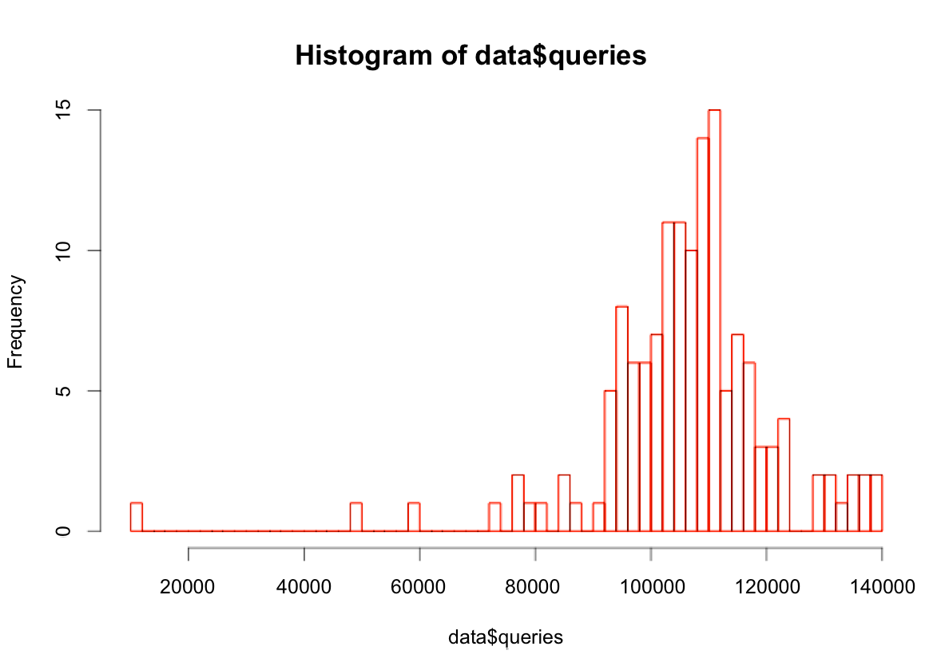
Histograms

Slide 28
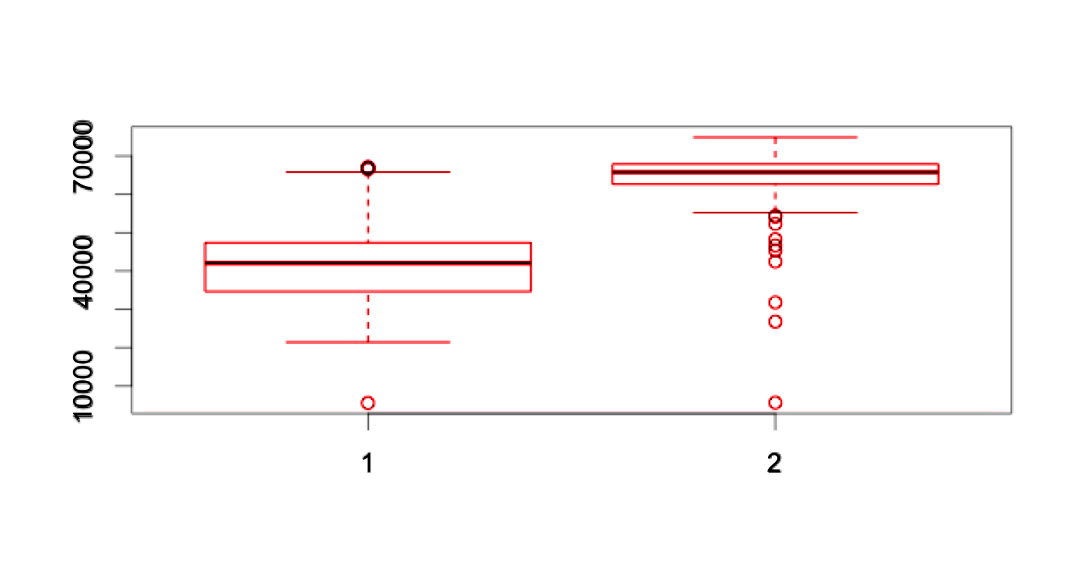
Boxplot
Notes:
The body of the boxplot consists of a "box" (hence the name) that goes from the first quartile (Q1) to the third quartile (Q3). Within the box, a vertical line is drawn at the Q2, the median of the data set. Two horizontal lines, called whiskers, extend from the front and back of the box. Min —> Q1 —> Median —> Q3 —> Max

Slide 29
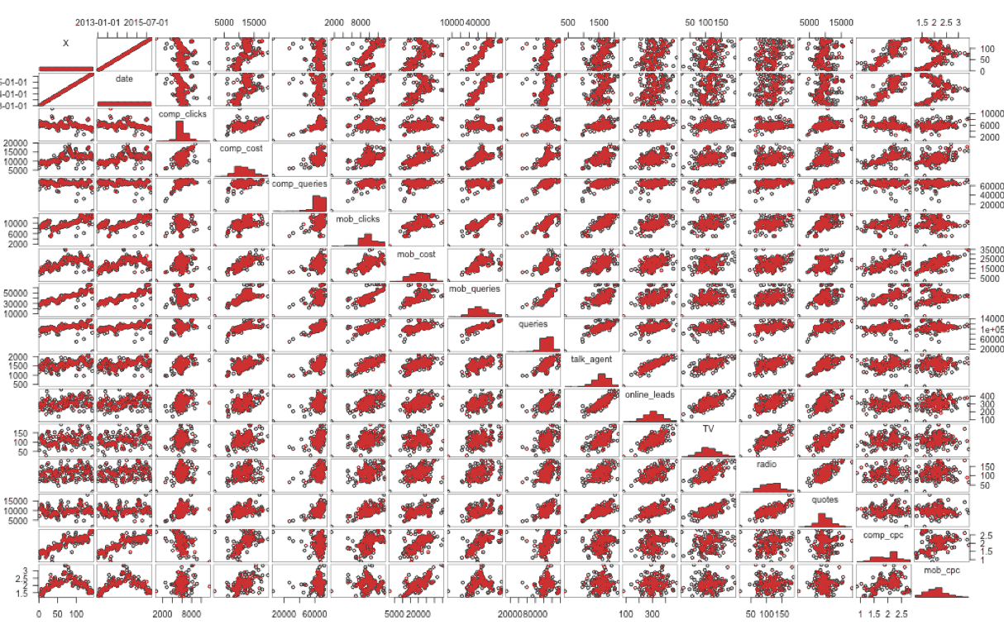
Bonus: Package Gpairs (the power of R)

Slide 30
Use Visualization to Reveal Patterns and Stories in Data
Understand the analysis situation you face: Conceptual or data driven? Declarative or exploratory?
Choose the visualization technique that will most effectively illuminate the pattern you seek
Use a tool that efficiently creates the visualization you need
Calibrate the amount of chart polish you apply to where you are on your communication journey

Slide 31
References
Felton, N. (2008). How Americans Spend Their Money [Online image]. Retrieved from https://goo.gl/vNNdYH

Slide 32
Being Planful When Creating Dataviz
Module 3 Lesson 2

Slide 33
Being Planful When Creating Dataviz
Planning the approach to dataviz, with careful attention to each phase, will save time and improve the end product

Slide 34
Each Quadrant Requires Different Forms of Visualization
The four types of charts
Declarative
Idea illustration
Everyday dataviz
Conceptual
Data Driven
Idea generation
Visual discovery
Exploratory
Source: Adapted from Scott Berinato, “Good Charts: The HBR Guide to Making Smarter, More Persuasive Data Visualizations.”

Slide 35
Data Storytelling Is Best Done When Charts Are Involved
The four types of charts
Declarative
Conceptual
Data Driven
Exploratory
Source: Adapted from Scott Berinato, “Good Charts: The HBR Guide to Making Smarter, More Persuasive Data Visualizations.”

Slide 36
Data Storytelling Is Best Done When Charts Are Involved
The four types of charts
Declarative
Conceptual
Data Driven
Exploratory
Source: Adapted from Scott Berinato, “Good Charts: The HBR Guide to Making Smarter, More Persuasive Data Visualizations.”

Slide 37
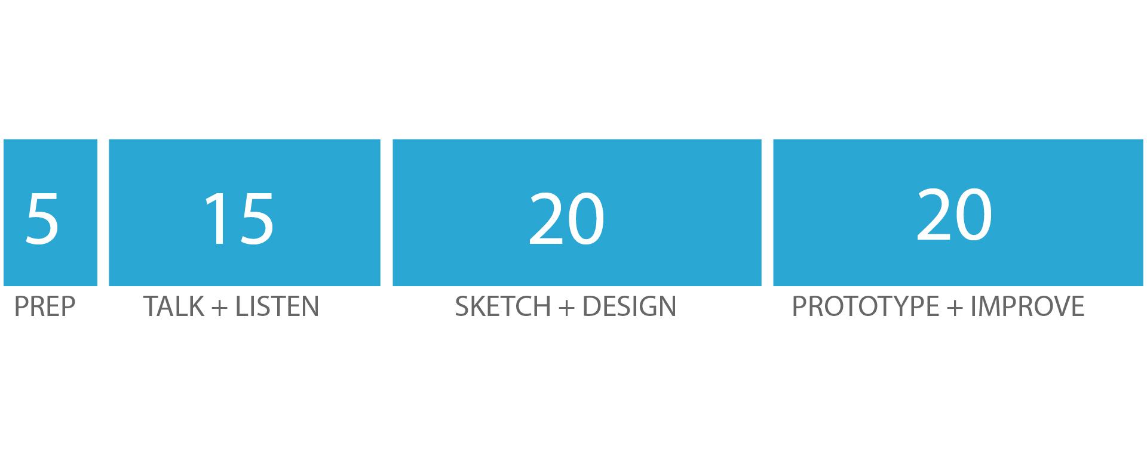
Thorough Process Is an Antidote to Auto-Generated Charts
Minutes spent on each task
Source: Adapted from Scott Berinato, “Good Charts: The HBR Guide to Making Smarter, More Persuasive Data Visualizations.”

Slide 38
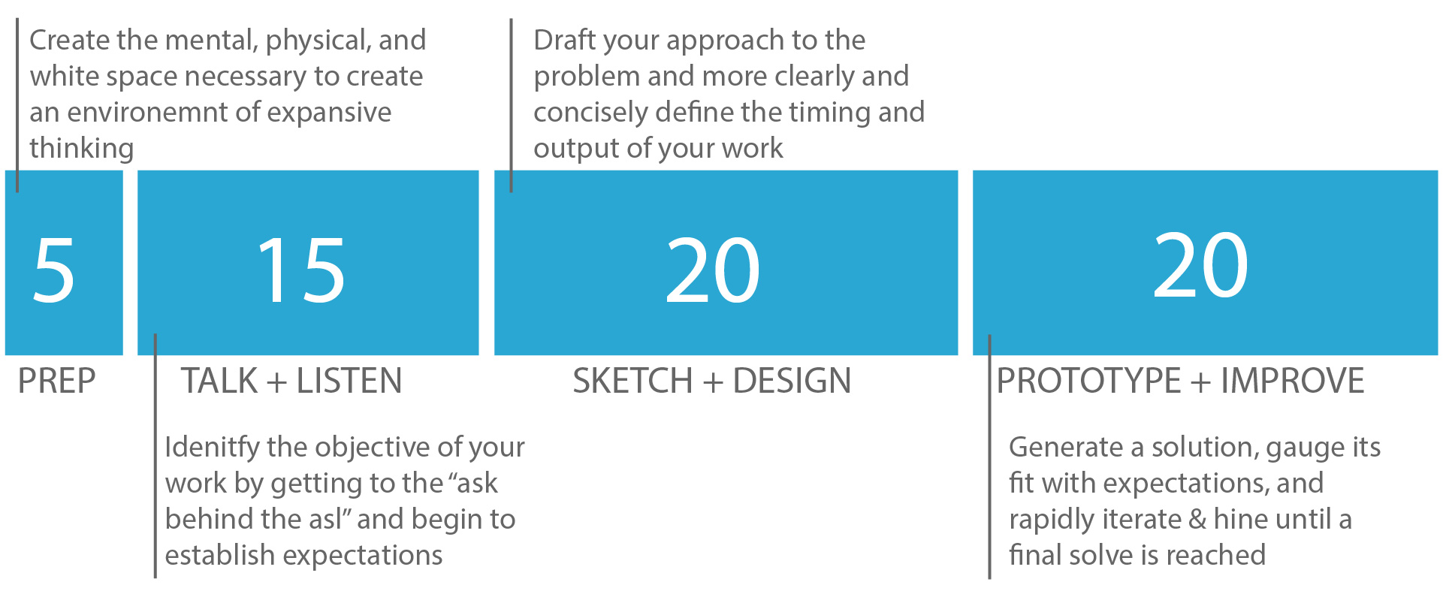
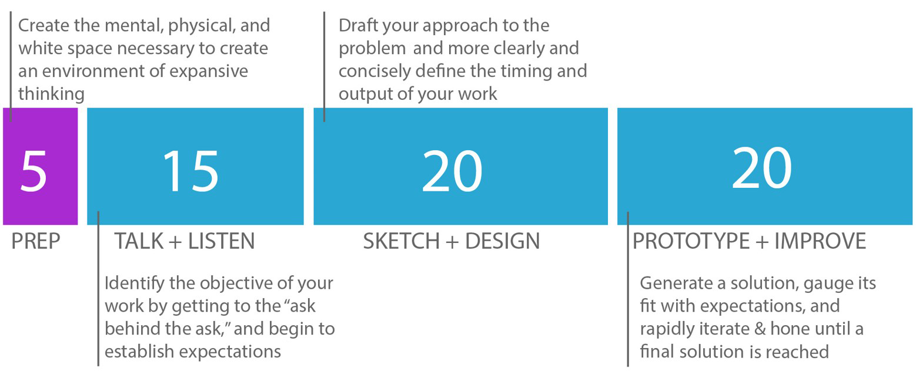

Each Step Is Necessary to Producing High Quality Dataviz
Minutes spent on each task
Source: Adapted from Scott Berinato, “Good Charts: The HBR Guide to Making Smarter, More Persuasive Data Visualizations.”

Slide 39
Each Step Is Necessary to Producing High Quality Dataviz
Minutes spent on each task
.
Source: Adapted from Scott Berinato, “Good Charts: The HBR Guide to Making Smarter, More Persuasive Data Visualizations.”

Slide 40
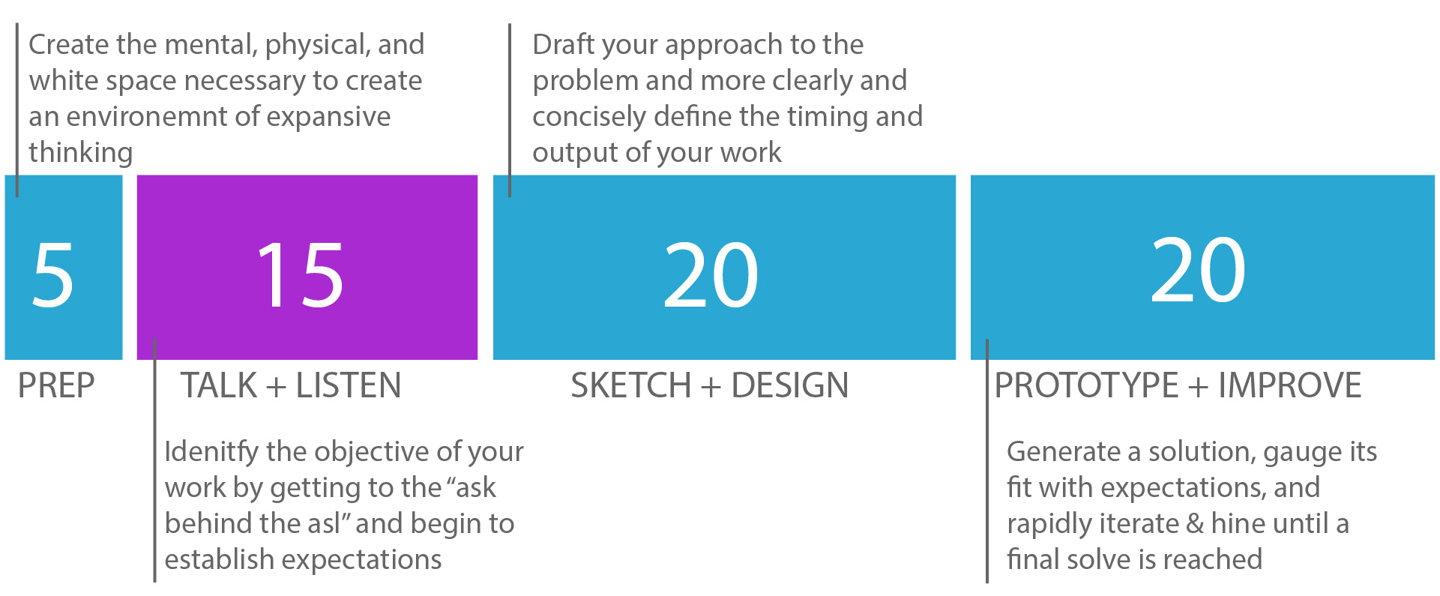
Each Step is Necessary to Producing High Quality Dataviz
Minutes spent on each task
Source: Adapted from Scott Berinato, “Good Charts: The HBR Guide to Making Smarter, More Persuasive Data Visualizations.”

Slide 41
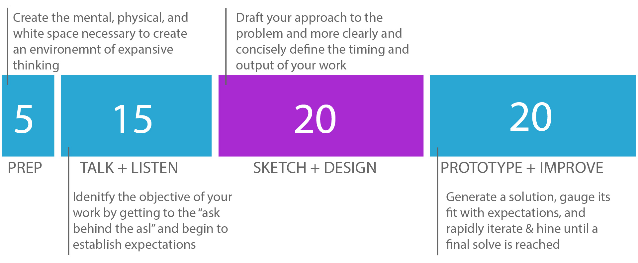
Each Step is Necessary to Producing High Quality Dataviz
Minutes spent on each task
Source: Adapted from Scott Berinato, “Good Charts: The HBR Guide to Making Smarter, More Persuasive Data Visualizations.”

Slide 42
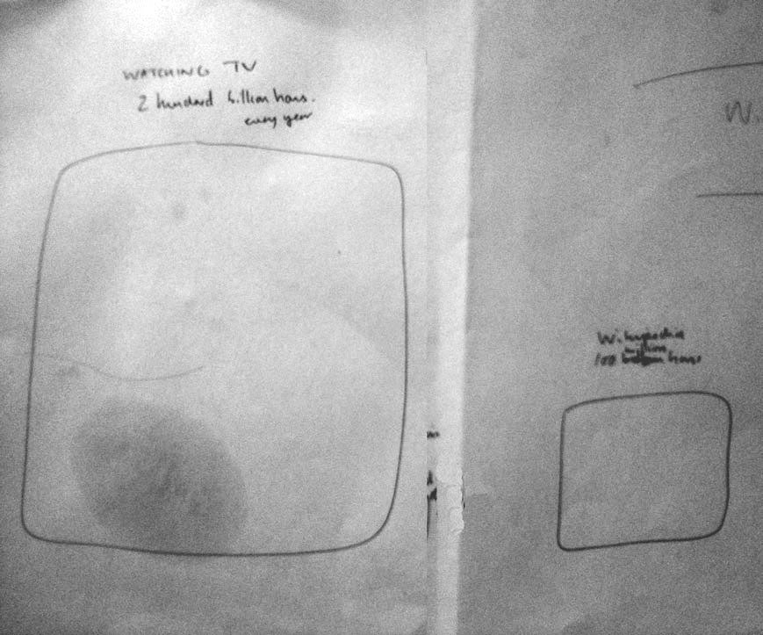
Source: David McCandless

Slide 43
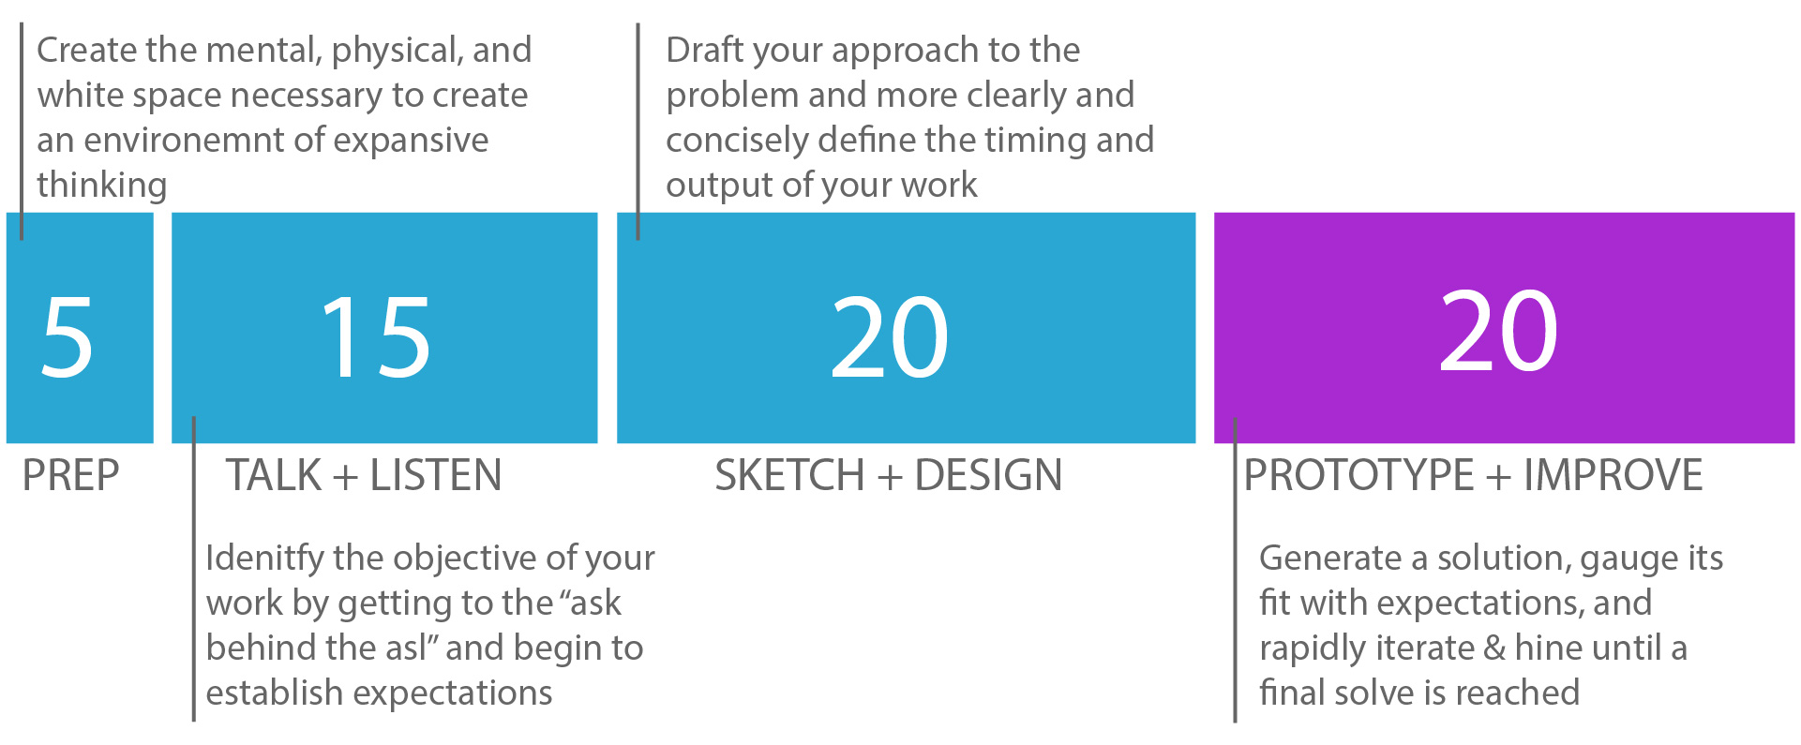
Each Step is Necessary to Producing High Quality Dataviz
Minutes spent on each task
20
Source: Adapted from Scott Berinato, “Good Charts: The HBR Guide to Making Smarter, More Persuasive Data Visualizations.”

Slide 44
Dutifully Approaching Dataviz Creation Produces Better Results
Transitioning visualizations from “work product” to “client ready” requires attention to detail
Planning the approach to dataviz creation helps ensure each element of the process is sound
Sketching visualizations will ultimately save time and effort
Producing a final dataviz is a study in iteration, not a “one-and-done” experience

Slide 45
Understanding the Components of Visual Form
Module 3 Lesson 3

Slide 46
Understanding the Components of Visual Form
Knowing what comprises visual form ⎯ and what constitutes “good” for each element ⎯ is crucial to create great dataviz

Slide 47
McCandless Offers a Thorough Definition of Good Data Stories

Slide 48
McCandless Offers a Thorough Definition of Good Data Stories

Slide 49
Good Visual Form Has Three Essential Elements
Sophisticated
Use of Contrast
Clear
Meaning
Refined
Execution
Source: Adapted from Dona Wong, “The WSJ Guide to Information Graphics.”

Slide 50
Good Visual Form Has Three Essential Elements
Separates important data from the rest via visual context
Sophisticated
Use of Contrast
Clearly communicates the insight we intend
to convey
Clear
Meaning
Refined
Execution
Applies visual polish to bring deep attention to detail to the visual

Slide 51
This Framework Offers an Useful View of Dataviz Execution
Provides a detailed definition to McCandless’s concept of visual form
Defines elements that the dataviz author can reasonably affect and control
Reveals the connection between the process of data analysis and the final image that is produced

Slide 52
Enriching Content Through Connection
Module 3 Lesson 4

Slide 53
Enriching Content Through Connection
Giving meaning to dataviz and the numbers that comprise them requires a shift from facts to emotional connection

Slide 54
Good Visual Form Has Three Essential Elements
Separates important data from the rest via visual context
Sophisticated
Use of Contrast
Clearly communicates the insight we intend
to convey
Clear
Meaning
Refined
Execution
Applies visual polish to bring deep attention to detail to the visual

Slide 55
Good Visual Form Has Three Essential Elements
Sophisticated
Use of Contrast
Separates important data from the rest via visual context
Clearly communicates the insight we intend
to convey
Clear
Meaning
Refined
Execution
Applies visual polish to bring deep attention to detail to the visual

Slide 56
Contrast comes in four primary forms
Size contrast
Color contrast
Shape contrast
Contrived contrast
Introducing different-size objects on a page captures attention. The more striking and apparent the size difference, the more attention the objects will attract.
Contrasting colors in an image can be an effective way to attract attention. A muted color for a chart background can draw attention to important elements in a vibrant color.
Differences in shapes express the uniqueness of each element instantly. Icons are a particularly effective form of Shape Contrast that immediately communicate differences.
Use of boxes, callouts, annotations and other preattentive attributes to distinguish items in a visual. These are planned introductions of contrast to attract attention.

Slide 57
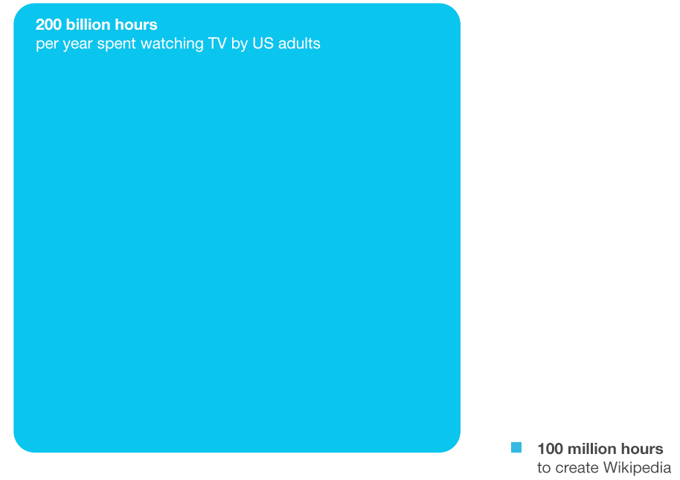

Slide 59
Form submissions
Newsletter sign-ups
Chat contacts
Email
contacts
Phone
calls
Cross-device activity
Profile
fill-outs
$
Return site visits
Offline dealer lookups
Perception change
App downloads
In-app purchases
Video
views
Page
visits

Slide 61
Enrich Your Content by Connecting to Your Audience
Contrast separates the important data from the unimportant through visual context
Visual contrast comes in four primary forms – size, color, shape, and contrived
Each technique is effective at drawing our audience’s attention to elements of our chart

Slide 62
In This Module
Module 3: Your Guide to Creating Visualizations
Key Concepts
Finding patterns in data
Being planful when creating dataviz
Understanding the components of visual form
Enriching Content Through Connection

Slide 63
References
Felton, N. (2008). How Americans Spend Their Money [Online image]. Retrieved from https://goo.gl/vNNdYH
Joint Economic Committee. (2010). Health care chart [Online image]
Stanley, M. (2008). Peak Break-Up Times [Online image]

